Slide 1
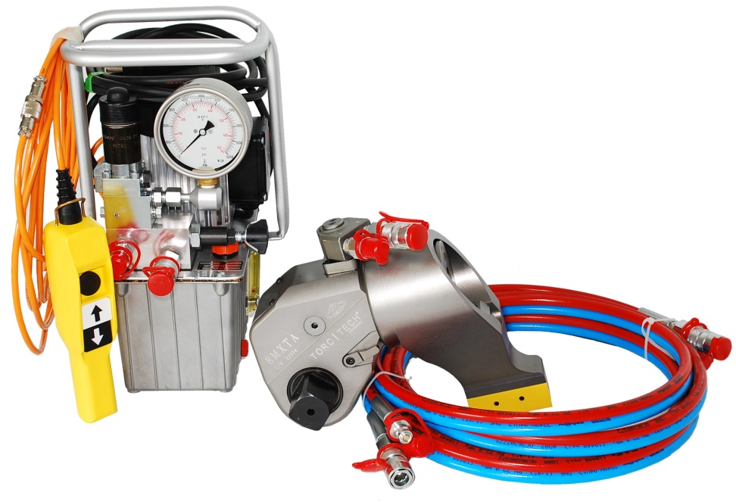
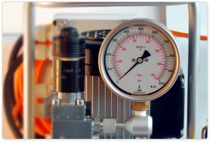
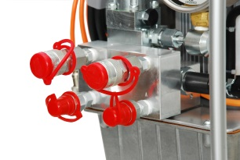
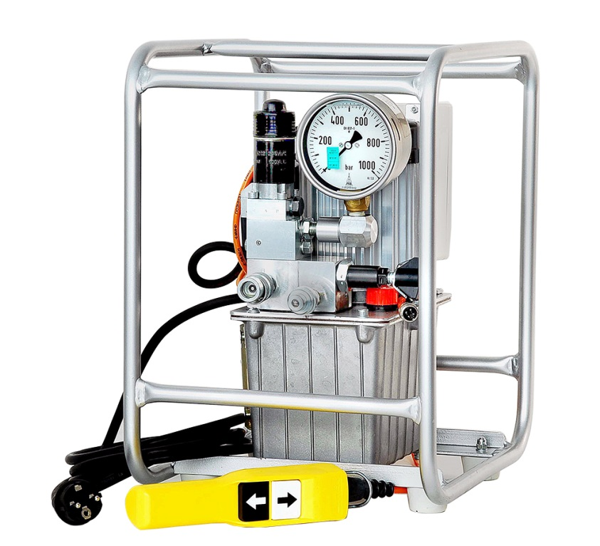
HE-Series
800 Bar
Hydraulic Torque Pumps
Working pressure 800 bar maximum
40-800 bar stepless pressure adjustment available
Multipoint connection for more torque wrenches
Double and three stage high performance pump units
Calibrated, Clas 1, 1000 bar, Ǿ 100mm pressicion gauge
Designed for high performance and continuous operations
Oil filter, oil cooler and flat stable oil tank by FE series
Oil level indicator - thermometer and protecting frame
German made with CE marking, after sales service in Turkey
HE-025-3
Model No | HE-025-3-230 | HE-055-2-230
Operating Voltage | 110 / 115 / 230 Voltage | 110 / 115 / 230 Voltage
Electric Motor Power | 0,25 kW | 0,37 kW
Oil Displacement | 3 - Stages | 2 - Stages
Flow Rate | 3,2 - 0,9 - 0,4 L/min. | 5,0 – 0,7 L/min.
Oil Capacity | 3 Litre | 5 Litre
Carrying Handle | Available | Available
Cooling System | Not Available | Not Available
Weight | 23 Kg | 29 Kg
Sizes (U-G-Y) | 36 x 30 x 44 cm | 45 x 34 x 52 cm
Recommended Oils | Mobil DTE24 - Tellius 32 - Energol HLP-HM32
HE-055-2
Surkon Makina Sanayi Ticaret Limited Şirketi
İvedik Org. San. Bölgesi - Özpetek Sanayi Sitesi 1390 Sokak.- No: 12 – TR-06378 – Yenimahalle / ANKARA Tel: (0 312) 386 14 64 / Faks: (0 312) 386 14 88
e-mail : eposta@surkon.com www.surkonmakina.com

